Slide 1
Well, Well
Modeling the Impacts of a Well on Flow and Head

Slide 2
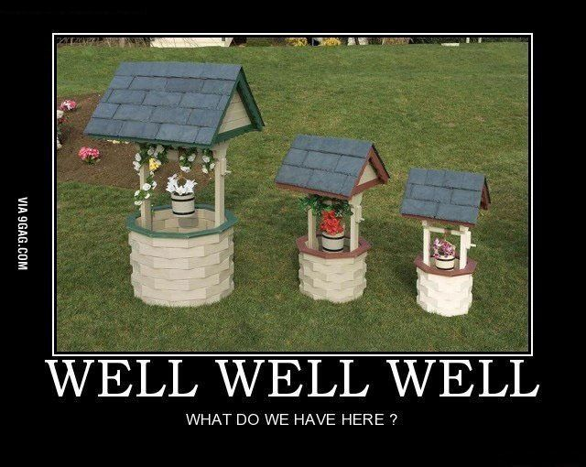

Slide 3
The Challenge
flow
Ly
Q1:Plot flow along y for inflow and outflow

Slide 4
The Challenge
flow
before well
at well
Ly
Q2:Plot flow across two vertical transects:
at well position
just before well

Slide 5
The Challenge
Ly
Lx
Q3: Describe equipotentials and flow vectors, approximate well’s capture zone

Slide 6
The Challenge
Ly
Lx
Q4: Explain why drawdown contours aren’t circles

Slide 7
The Challenge
Ly
Lx
Q5: Move well and describe new flow

Slide 8
BREAKROOM
Room1: Q1 and Q2 (Explain transects in boundary, center, and before the center)
Room2: Q3 and Q4 (Draw capture zone and explain drawdown)
** Random splitting, screenshot both Room 1 and 2 slides**
***Be prepared, we have some extra questions for each room***

Slide 9
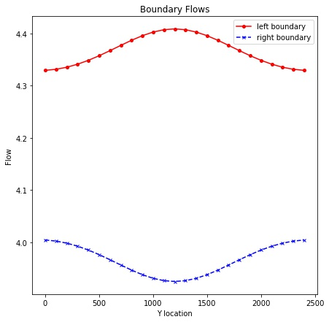
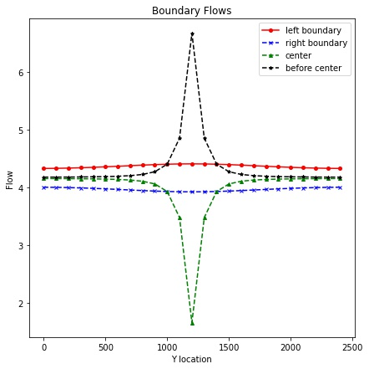
Room 1: Could you explain the shape of the transects?
What does this surface symbolize?
What does this surface symbolize?

Slide 10
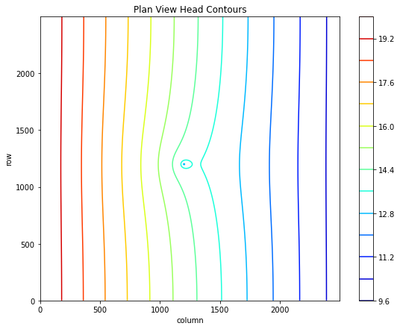
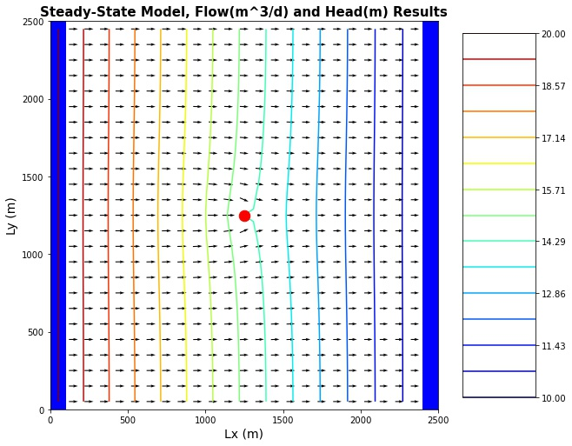
Room 1: Fill in Flow Vectors and delineate capture zone
Example
Could you delineate it here?

Slide 11

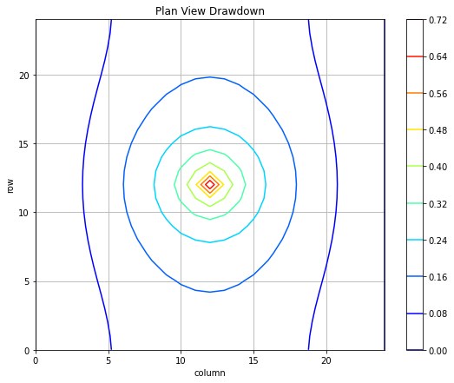
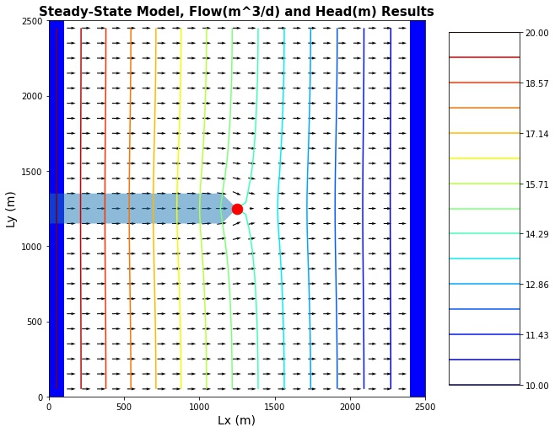
ROOM 2: Could you explain the shape of the drawdown?

Slide 12

Type I?
Type II?

Slide 13
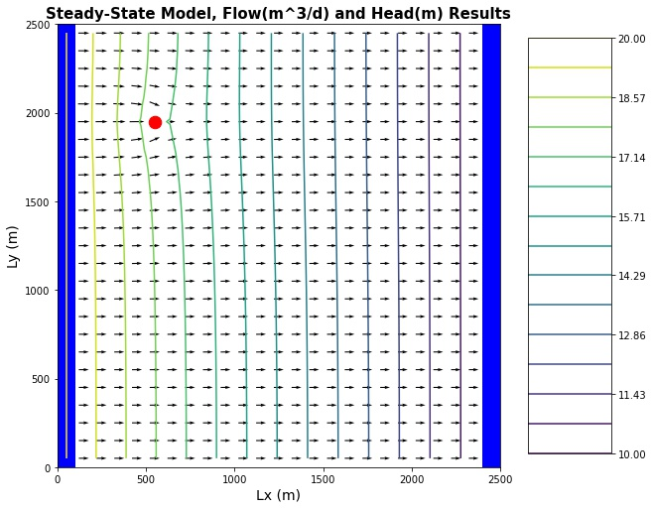
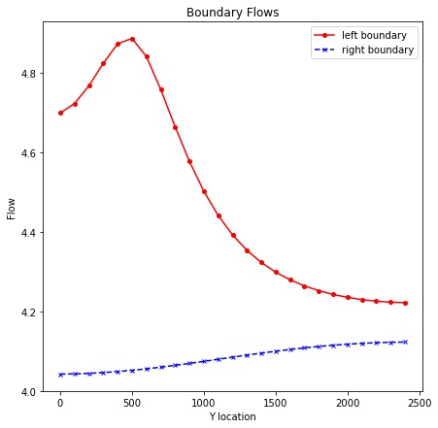
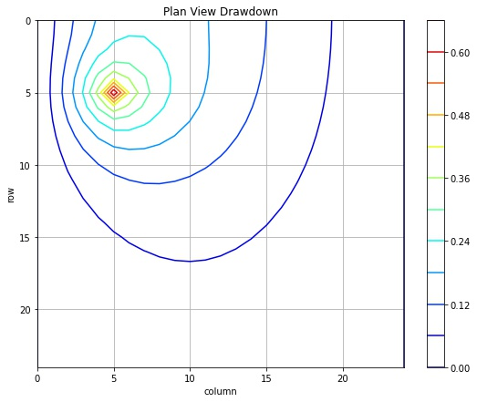
1 - 2 volunteers (Different from who already has talked)
Describe how water is flowing through the domain.

Slide 14

Technical issues? Final comments?
plt.ylim(initial value, final value) It could be in reverse order
plt.contour(water_head, cmap='jet', levels=10)
Why the model fails with Qwell>21 m3/day?
others?

